Slide 1
ML Math-percentage-percentile

Slide 2
Percentage and Percentile
What is a Percentage?
A percentage is just a number out of 100.
If you scored 90% on a test, it means
you got 90 out of 100 marks or
9 out of 10 or
18 out of 20
180 out of 200 and so on.
What is percentile ?
A percentile is a value below which a certain percentage of data falls. It shows the relative standing of a value within a dataset.
If you are in the 90th percentile of a test, it means
you scored better than 90% of the people who took it or
you can say that 90% of students are below your score.

Slide 3
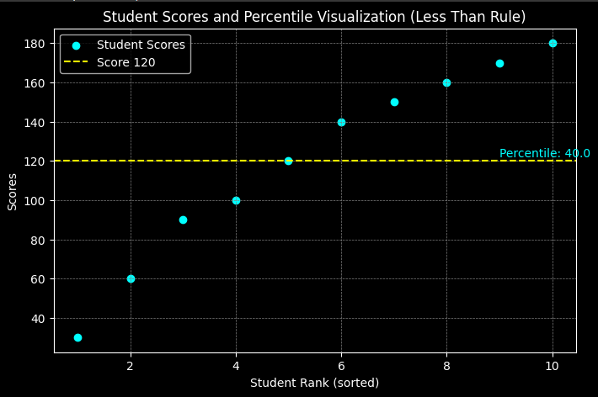
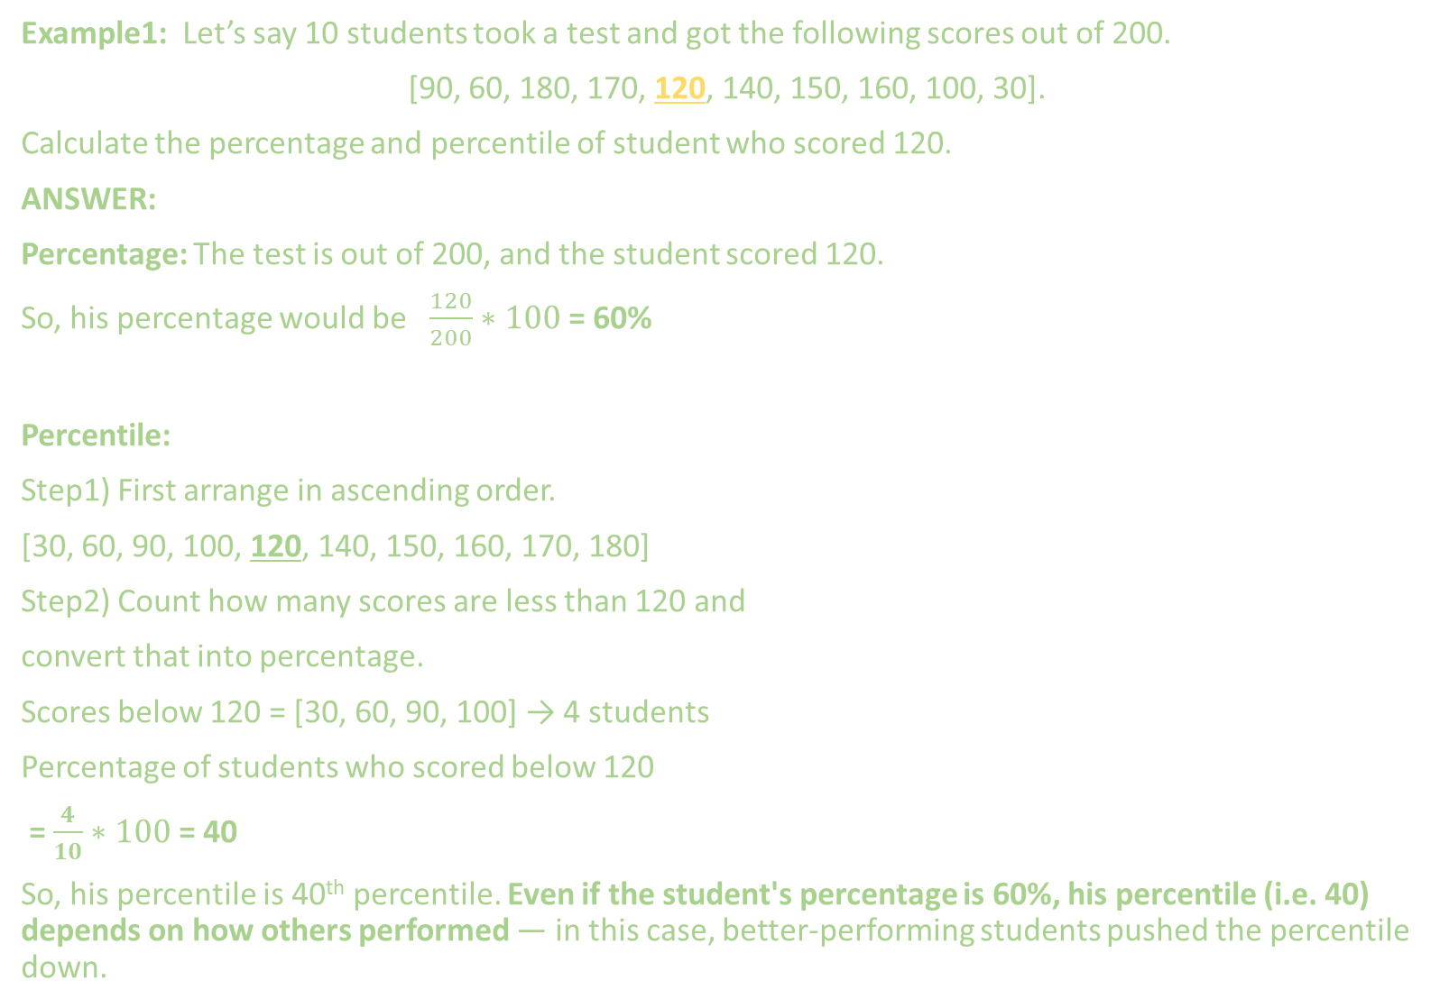
Example1: Let’s say 10 students took a test and got the following scores out of 200.
[90, 60, 180, 170, 120, 140, 150, 160, 100, 30].
Calculate the percentage and percentile of student who scored 120.
ANSWER:
Percentage: The test is out of 200, and the student scored 120.
So, his percentage would be $\frac{120}{200}∗100$ = 60%
Percentile:
Step1) First arrange in ascending order.
[30, 60, 90, 100, 120, 140, 150, 160, 170, 180]
Step2) Count how many scores are less than 120 and
convert that into percentage.
Scores below 120 = [30, 60, 90, 100] → 4 students
Percentage of students who scored below 120
= $\frac{4}{10}∗100$ = 40
So, his percentile is 40th percentile. Even if the student's percentage is 60%, his percentile (i.e. 40) depends on how others performed — in this case, better-performing students pushed the percentile down.

Slide 4
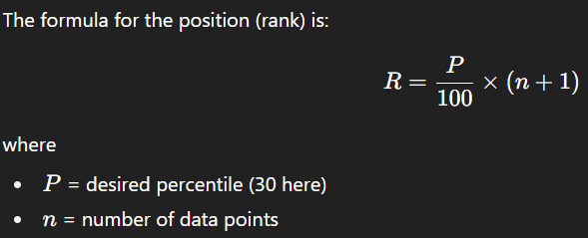
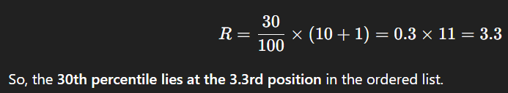
Example2: Let’s say 10 students took a test and got the following scores out of 200:
[30, 60, 180, 170, 120, 140, 150, 160, 100, 90].
Calculate the score at 30th percentile.
ANSWER:
1) First arrange in ascending order:
[30, 60, 90, 100, 120, 140, 150, 160, 170, 180]
2) Calculate the rank (position):
3) Interpolate if necessary:
The rank is 3.3, which means the 30th percentile lies between the 3rd and 4th values in the sorted list:
3rd value = 90
4th value = 100
Now interpolate between these two (explained on next page):
30th percentile = 90 + 0.3 × (100 − 90)
= 90 + 3
= 93
Interpretation: 30% of students scored below 93.

Slide 5
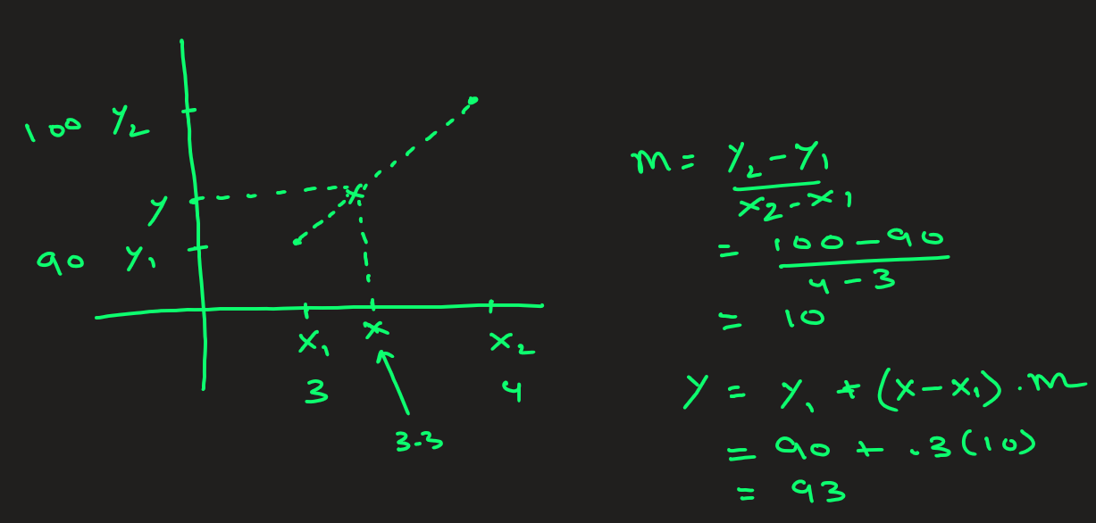
Linear Interpolation Explained

Slide 6
STOP

Slide 7
Practice: Percentile (p2)
Example3:
Let's say 10 students took a test and got the following scores out of 200:
[45, 50, 65, 70, 75, 185, 80, 55, 60, 190].
a) Compute percentage and percentile of student who scored 80.
ANSWER: a) Arrange the numbers in ascending:
[45, 50, 55, 60, 65, 70, 75, 80, 185, 190].
Percentage of students who scored 80 = (80/200) * 100 = 40%
Percentile of this student who scored 80 = There are 7 students out of 10 whose scores are below 80:
So percentile of this student is (7/10) * 100 → 70th percentile

Slide 9
ML Math-PERCENTAGE-percentile

Slide 10
What is Statistics?
Fndksfndsklf
Fnkjsdfkls’/
Nfkslj/dfjls
nfkldsfs

Slide 11
Fjlkfdljf
Hfdslfds
fksdljfsD|]
fkdslfa

